Slide 1
Bicycle Hire Planner
“It’s Not a Bug It’s a feature” Client Meeting

Slide 2
Clarifications
Meeting Timeline
Login
Offline Capability
Starting Trip & Ending Trip
Payment
Large Group & Group Corner Case
Trip Information Sharing
Security & Redundancy

Slide 3
User Stories and Epics

Slide 4


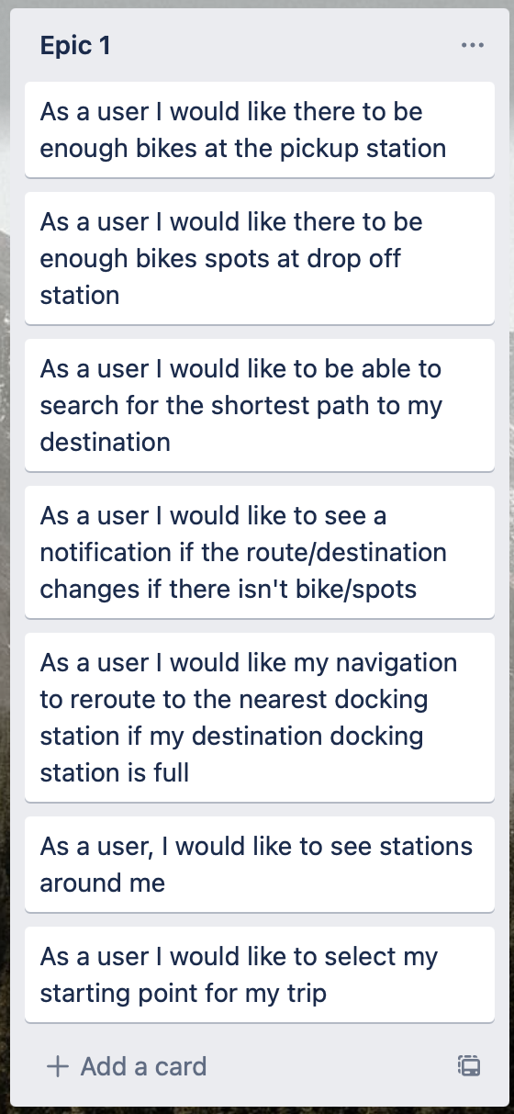
Epic one
Minimum Working Application
Basis for Functionality
Single user Trip
Must Have

Slide 5
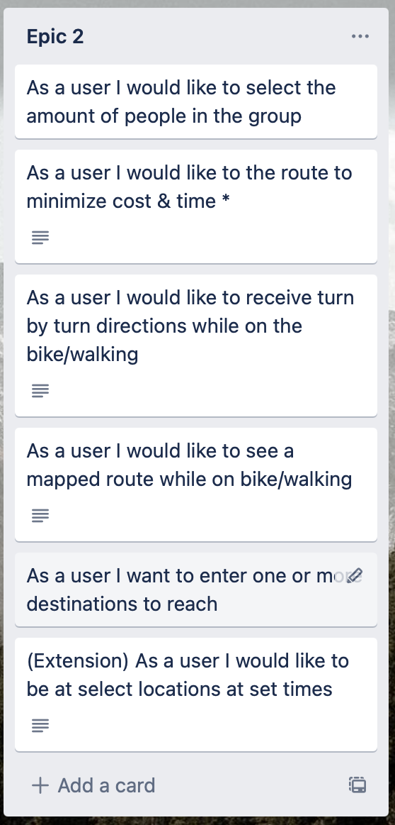
Epic Two
Extension for Multiple User Group
Satisfy Project Brief
Should Have

Slide 6
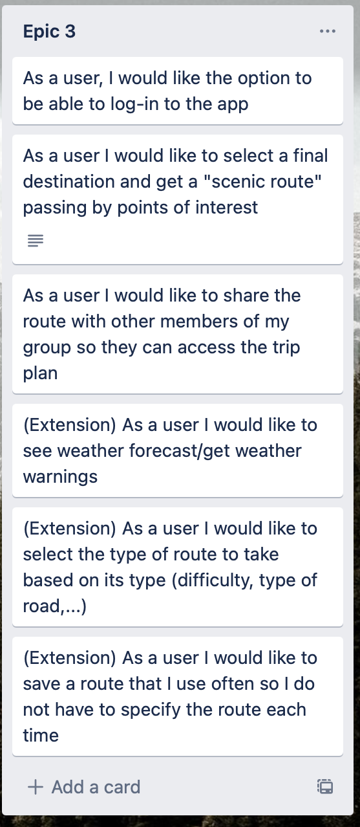
Epic Three
Further Tourist Use Case Extension
Everyday & Commuter Extension
Could Have

Slide 7

Epic Four
Potential Future Directions (Feasibility)
May Have

Slide 8
User Interface

Slide 9
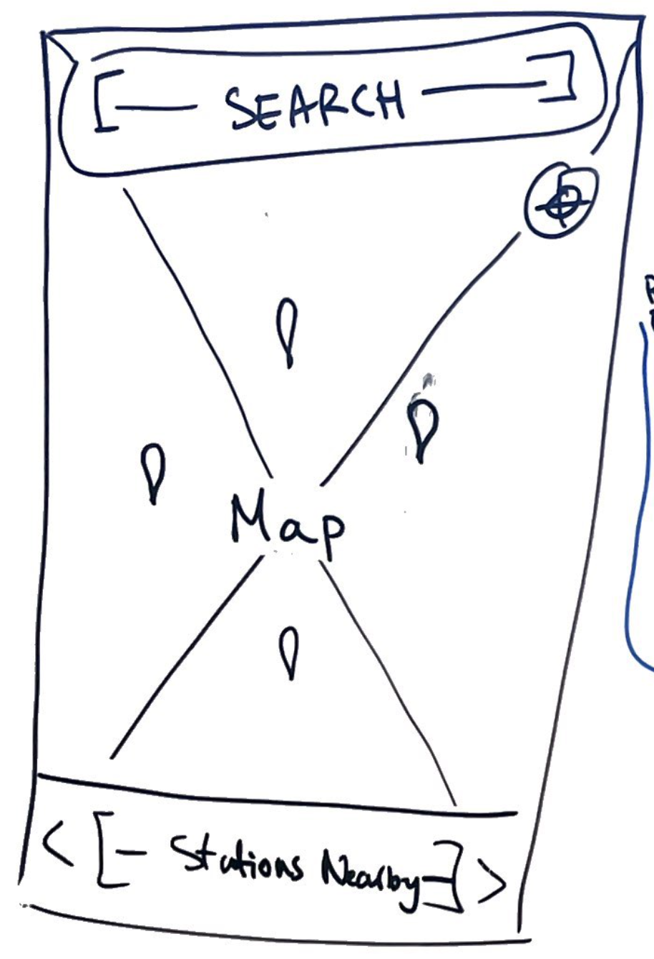
Home Page
Search Bar: Look up Final Destination
Points on Map: Nearby Stations
Recenter Button
Nearby Station List: Route from Station

Slide 10
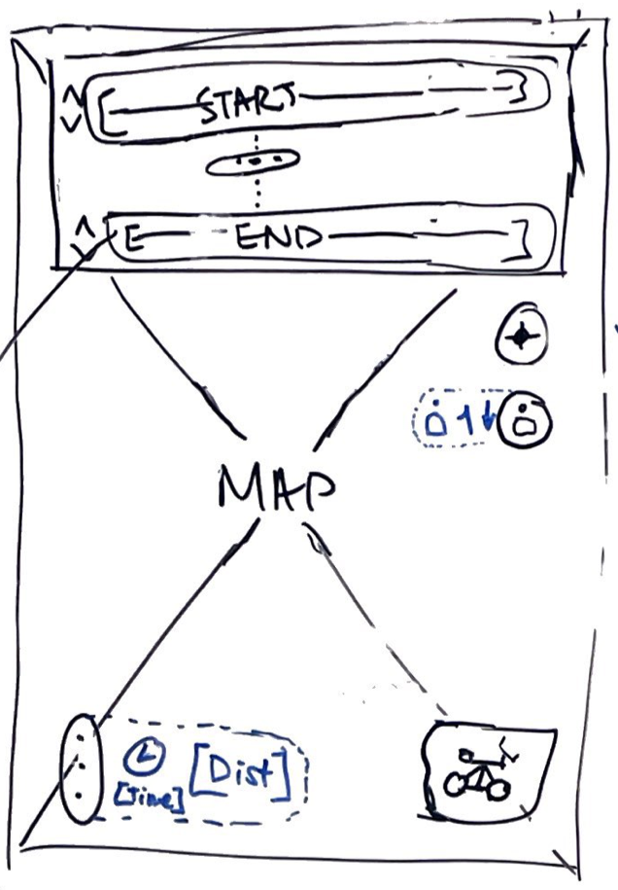
Route Planning
Start & End Destinations
Intermediate Destinations
Recenter Button
Group Settings/Size
Map: Displays Route

Slide 11
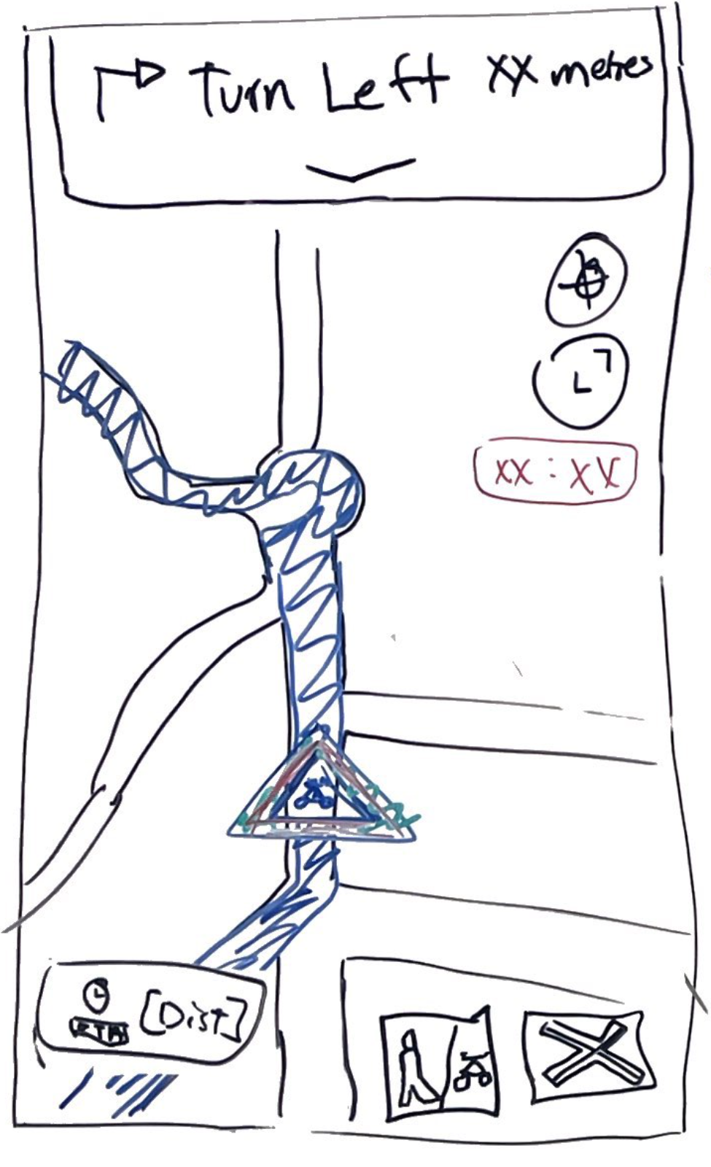
Navigation
Next Turn: Swipe Down for List of Turns
Recenter Button
Display Full Route Button
Remaining Time on Bike (Before 30min Cutoff)
Map Displays Route
Remaining Time Distance
Bicycle Toggle
Cancel Trip Button

Slide 12
Questions & Clarifications

